Slide 1

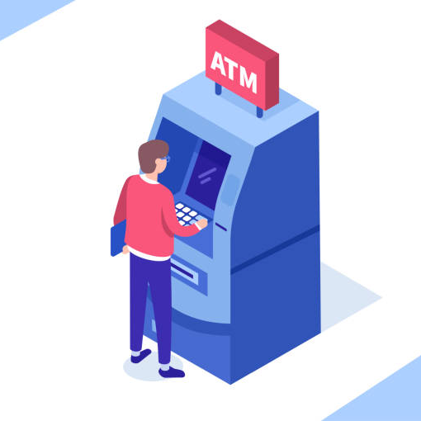
Atm simulation system
JAVA LAB PROJECT
GROUP-9

Slide 2

Group members
1) NITTALA RAMA KIRAN - LCI2020006
2) NUNNA SHYAM PRAVEEN - LCI2020036
3) BADIREDDY SHAMITHA - LCI2020060
4) ABHINAV JALLURI - LCI2020068
5) BANOTH SRIKANTH - LCI2020079
6) RUTHVIKA KALSANI - LCS2020038

Slide 3
Division of topics
RAMA KIRAN - INTRODUCTION AND ATM WORKING CONCEPT
SHAMITHA - DEPOSIT AND TRANSFER CONCEPT
SRIKANTH - WITHDRAWAL CONCEPT
ABHINAV - TRANSACTION CONCEPT
RUTHVIKA - BANK DATABASE (STORAGE) CONCEPT
SHYAM PRAVEEN - CLIENT – SERVER COMMUNICATION CONCEPT AND SUMMARY

Slide 4
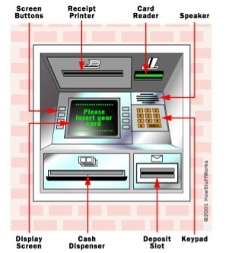
INTRODUCTION
An automated teller machine (ATM) is a computerized telecommunications device.
It provides the customers of a financial institution / bank with access to financial transactions in a public space without the need for a human clerk or bank teller round the clock (24 hours a day).

Slide 5
Motivation
To help the Banking system to be more efficient.
To create an user friendly environment that motivates user to perform transactions easily and securely.
To help the Banking systems keep proper records of all the transactions.
The push for our project ATM simulation system was motivated by the need to shorten banking hours, reduce congestion in bank branches, and cut labor costs.
The prospect of attracting more customers with shiny new gadgetry appealed to the businessmen and opened the doors to up-selling them on loans and credit cards.

Slide 6
OBJECTIVES
This project has been created to provide a user-friendly ATM simulation interface using JAVA.
Our main objectives to be achieved are:
We have used inheritance, abstraction, multithreading, synchronization and other java topics to achieve our task.
We are going to mention the way how we achieved our objectives in the following slides.
View account Balances
Deposit Cash
Withdraw Cash
Transfer the amount
Chat with Helpline (Customer-care)

Slide 7
Project Description
ATMApp.java:
It is the source file of the project containing main method.
ATM.java:
Firstly, the user authentication will be checked, when you have entered your Account number and your PIN.
It verifies your credentials with the Bank database.
It allows you to use its keypad where you can able to enter your details.
All the objects of several classes get initialized in this file.
After login, user is allowed to choose an option from the display menu.
According to the option chosen corresponding object will be created.

Slide 8
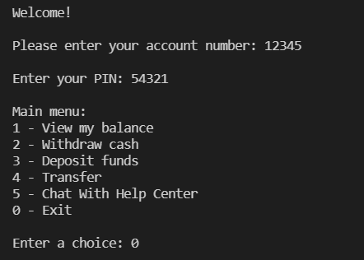
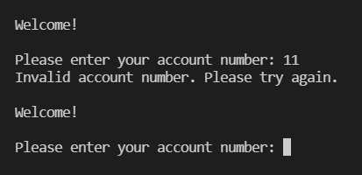
If the credentials are incorrect
If the credentials are correct
DISPLAY MENU

Slide 9
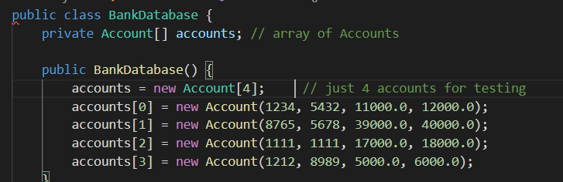
Account.java:
Object of this class is used to create new Accounts.
Account constructor initializes attributes used to create new account with Account number, Pin, Available Balance, Total Balance.
It stores the corresponding credentials of the account.
Using methods of this class we can check The Pin of a corresponding Account Number.
Total Account balance and available balance are returned using the methods of this class.
BankDatabase.java:
It uses the object of Account class to create new accounts.
It stores the corresponding objects of the account.

Slide 10
Transaction.java:
It is the base class where all the classes getting derived from, since there are many type of transactions such as withdrawal, deposit and transfer so it has to be declared abstract.
To perform the transaction abstract method is defined here so that it can be overridden by each subclass.
Some basic methods are defined in this class.
BalanceInquiry.java:
This class extends Transaction class and implements Runnable interface.
BalanceInquiry constructor is invoked by creating object BIrun in ATM class after the user chooses option1 with data (userAccountNumber, atmScreen, atmBankDatabase).
BalanceInquiry constructor -> Since it extends Transaction class , super keyword invokes parent class constructor.
Object of Balance Inquiry(BIrun) is created and used as runnable for creating the BIThread
BIThread is started and join method is used so the thread execution is not stopped until its completion.
BalanceInquiry overrides execute method to display the total balance and available balance of the user.
All synchronized blocks being synchronized on the same object can only have one thread executing inside them at a time.
All other threads attempting to enter the synchronized block are blocked until the thread inside the synchronized block exits the block.

Slide 11
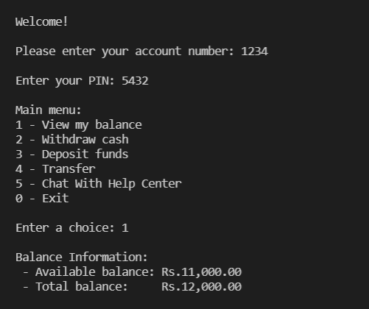
Output for Balance Inquiry
Choose option1

Slide 12
Deposit.java:
Deposit class is used to deposit cash and it takes the amount from user and updates the available and total balance of the user in bank database.
Deposit constructor is invoked by creating object D in ATM class after the user chooses option3 with data (userAccountNumber, atmScreen, atmBankDatabase, atmKeypad, atmDepositSlot).
Deposit constructor -> Since Deposit class extends Transaction class , super keyword invokes parent class constructor.
It is implementing Runnable interface and class needs to implement run() method.
All synchronized blocks being synchronized on the same object can only have one thread executing inside them at a time.
All other threads attempting to enter the synchronized block are blocked until the thread inside the synchronized block exits the block.
DepositSlot.java:
The method is used to check whether deposit envelope was received or not.

Slide 13
Transfer.java:
It is used to transfer money from one account to another.
Transfer constructor is invoked by creating object T in ATM class after the user chooses option4 with data (userAccountNumber, atmScreen, atmBankDatabase, atmKeypad).
Transfer constructor -> Since Transfer class extends Transaction class , super keyword invokes parent class constructor.
It is implementing Runnable interface and class needs to implement run() method.
All synchronized blocks being synchronized on the same object can only have one thread executing inside them at a time.
All other threads attempting to enter the synchronized block are blocked until the thread inside the synchronized block exits the block.

Slide 14
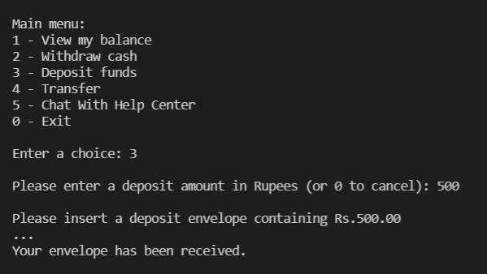
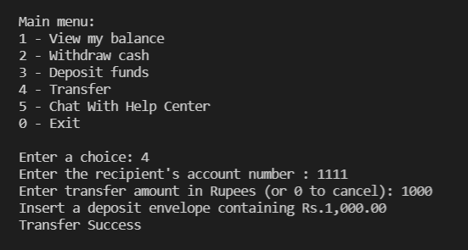
Deposit Money
Choose option 3
Transfer Money
Choose option 4

Slide 15
Withdrawal.java:
Withdrawal is used to draw the money from the ATM and it takes the amount from user and updates the available and total balance of the user in bank database.
Withdrawal constructor is invoked by creating object W in ATM class after the user chooses option2 with data (userAccountNumber, atmScreen, atmBankDatabase, atmKeypad, atmCashDispenser).
Withdrawal constructor -> Since Withdrawal class extends Transaction class , super keyword invokes parent class constructor.
It is implementing Runnable interface and class needs to implement run() method.
All synchronized blocks being synchronized on the same object can only have one thread executing inside them at a time.
All other threads attempting to enter the synchronized block are blocked until the thread inside the synchronized block exits the block.
CashDispenser.java:
Cash dispenser is used to sends an instruction to the ATM to dispense the amount requested.
It indicates whether cash dispenser can dispense desired amount.

Slide 16
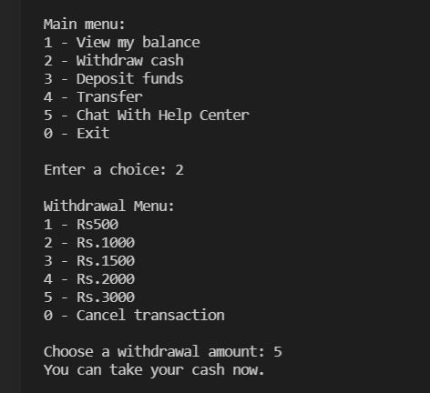
Withdrawal Money
Choose option 2

Slide 17
client.java and server.java:
In this application, client sends a message to the server, server reads the message and prints it.
Here, two classes are being used: Socket and ServerSocket.
The ServerSocket class can be used to create a server socket. This object is used to establish communication with the clients.
A socket is simply an endpoint for communications between the machines. The Socket class can be used to create a socket.
The Socket class is used to communicate client and server.
Through this class, we can read and write message.
The ServerSocket class is used at server-side.
The accept() method of ServerSocket class blocks the console until the client is connected.
After the successful connection of client, it returns the instance of Socket at server-side.
To create the server application, we need to create the instance of ServerSocket class. Here, we are using 1234 port number for the communication between the client and server.

Slide 18
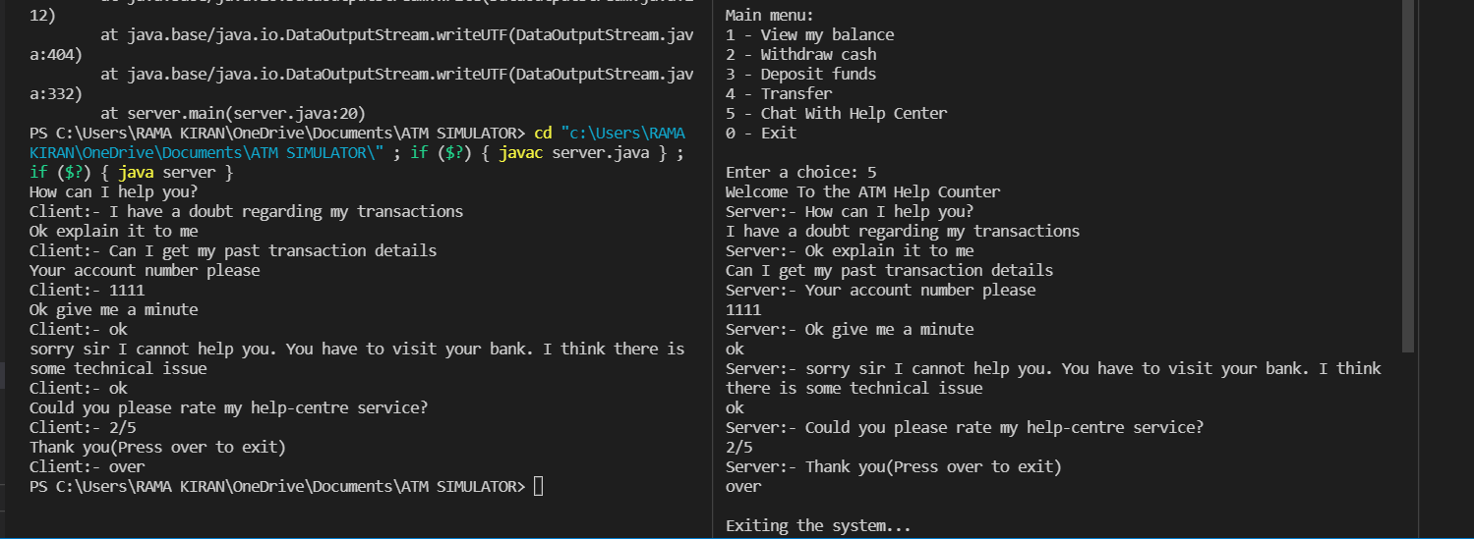
Using networking to establish a connection between client and server
Server
Client

Slide 19
Summary
By using the multi-threading, synchronization, inheritance, method overriding, encapsulation and other java concepts we achieved our objectives.
Using an ATM, customers can access their bank deposit or credit accounts in order to make a variety of financial transactions, most notably cash withdrawals and balance checking, as well as transferring credit to and from mobile phones.
IDEAS:
In future, the project has scope to be turned out into an online banking website(interface) so it can be used anywhere and anytime easily.
As the future is going to be more on Digital World we want to convert into an online interface so it can be more user-friendly.
We may also add more features to this project to make it more useful and easier to use.

Slide 20
Conclusion
While working on this project we have gained much command on Java.
“ Keeping subject apart, In this journey we have realized the importance of team work and learnt a lot of new things which are going to be helpful in our future”.

Slide 21

Thank you!
http://www.contoso.com/

